Slide 1
Solutions By Substitutions

Slide 2












1st Order Linear
Separable Variables
1st Order Autonomous
$$a_{1}\left(x\right)\frac{dy}{dx}=g(x)$$
$$\frac{dy}{dx}=g\left(x\right)h\left(y\right)$$
$$\frac{dy}{dx}=h\left(y\right)$$
$$a_{1}\left(x\right)\frac{dy}{dx}+a_{0}\left(x\right)y=g(x)$$
Exact Equations
exact
$$\frac{∂M}{∂y}=\frac{∂N}{∂x}$$
$$\frac{\left(M_{y}−N_{x}\right)}{N}$$
$$μ\left(x\right)=e^{\int{\frac{\left(M_{y}−N_{x}\right)}{N}dx}}$$
$$M\left(x, y\right)dx+N\left(x,y\right)dy=0$$
$$f\left(x,y\right)=c$$
*in terms of x
*make exact
$$\frac{\left(N_{x}−M_{y}\right)}{M}$$
$$μ\left(y\right)=e^{\int{\frac{\left(N_{x}−M_{y}\right)}{M}dx}}$$
$$μM\left(x, y\right)dx+μN\left(x,y\right)dy=0$$
*in terms of y
Solutions By Substitutions

Slide 3





































Homogeneous Equations
$$f\left(tx, ty\right)=t^{α}f\left(x, y\right)$$
homogeneous function of degree $α$
$$f\left(tx, ty\right)={\left(tx\right)}^{4}+{\left(ty\right)}^{4}=t^{4}\left(x^{4}+y^{4}\right)=t^{4}f\left(x,y\right)$$
homogeneous function of degree $4$
$$M\left(x, y\right)dx+N\left(x,y\right)dy=0$$
Reduce to separable variables
$$M\left(tx, ty\right)=t^{α}M\left(x,y\right)$$
$$N\left(tx, ty\right)=t^{α}N\left(x,y\right)$$
$$M\left(u\right)du+N\left(v\right)dv=0$$
$$t=1/x$$
$$t=1/y$$
$$M\left(1, y/x\right)=x^{−α}M\left(x,y\right)$$
$$N\left(1, y/x\right)=x^{−α}N\left(x,y\right)$$
$$M\left(x/y, 1\right)=y^{−α}M\left(x,y\right)$$
$$N\left(x/y, 1\right)=y^{−α}N\left(x,y\right)$$
$$M\left(x,y\right)=x^{α}M\left(1, y/x\right)$$
$$N\left(x,y\right)=x^{α}N\left(1, y/x\right)$$
$$M\left(x,y\right)=y^{α}M\left(x/y, 1\right)$$
$$N\left(x,y\right)=y^{α}N\left(x/y, 1\right)$$
$$u$$
$$u$$
$$v$$
$$v$$
$$M\left(x,y\right)=x^{α}M\left(1, u\right)$$
$$N\left(x,y\right)=x^{α}N\left(1, u\right)$$
$$M\left(x,y\right)=y^{α}M\left(v, 1\right)$$
$$N\left(x,y\right)=y^{α}N\left(v, 1\right)$$
$$x^{α}M\left(1, u\right)dx+x^{α}N\left(1,u\right)dy=0$$
$$y^{α}M\left(v, 1\right)dx+y^{α}N\left(v,1\right)dy=0$$
$$y=ux$$
$$dy=udx+xdu$$
$$x=vy$$
$$dx=vdy+ydv$$
$$\frac{dx}{x}+\frac{N\left(1,u\right)}{M\left(1,u\right)+uN\left(1,u\right)}du=0$$
$$\frac{dy}{y}+\frac{M\left(v, 1\right)}{vM\left(v, 1\right)+N\left(v,1\right)}dv=0$$
*separable
*separable
just $x$
just $u$
just $y$
just $v$

Slide 4














Homogeneous Equation
1. Check if “Homogeneous”; $M$ and $N$ same degree $α$
$$M\left(x, y\right)dx+N\left(x,y\right)dy=0$$
$$M\left(tx, ty\right)=t^{α}M\left(x,y\right)$$
$$N\left(tx, ty\right)=t^{α}N\left(x,y\right)$$
2. Substitute either $u=y/x$ or $v=x/y$, whichever makes equation simpler
$$M\left(1, u\right)dx+N\left(1,u\right)dy=0$$
$$M\left(v, 1\right)dx+N\left(v,1\right)dy=0$$
3. If $u$, substitute for $dy$, and if $v$, substitute for $dx$
$$y=ux$$
$$dy=udx+xdu$$
$$x=vy$$
$$dx=vdy+ydv$$
4. Simplify into separable form
$$\frac{dx}{x}+\frac{N\left(1,u\right)}{M\left(1,u\right)+uN\left(1,u\right)}du=0$$
$$\frac{dy}{y}+\frac{M\left(v, 1\right)}{vM\left(v, 1\right)+N\left(v,1\right)}dv=0$$
$$M$$
just $x$
just $u$
just $y$
just $v$
5. Solve separable variables

Slide 5






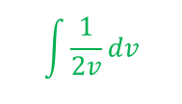







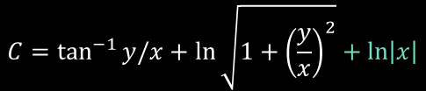



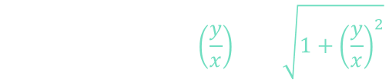










Example
1. Check if “Homogeneous”; $M$ and $N$ same degree $α$
$$\left(x−y\right)dx+\left(x+y\right)dy=0$$
$$M\left(x, y\right)dx+N\left(x,y\right)dy=0$$
$$M\left(tx, ty\right)=t^{α}M\left(x,y\right)$$
$$N\left(tx, ty\right)=t^{α}N\left(x,y\right)$$
$$M\left(x,y\right)$$
$$N\left(x,y\right)$$
$$\left(tx−ty\right)=t^{1}(x−y)$$
$$\left(tx+ty\right)=t^{1}(x+y)$$
2. Substitute either $u=y/x$ or $v=x/y$, whichever makes equation simpler
$$α=1$$
$$y=ux$$
$$\left(x−ux\right)dx+\left(x+ux\right)dy=0$$
5. Solve separable variables
$$v=1+u^{2}$$
$$dv=2udu$$
3. If $u$, substitute for $dy$, and if $v$, substitute for $dx$
$$\frac{dx}{x}= −\frac{\left(1+u\right)du}{\left(1+u^{2}\right)}$$
$$udu=\frac{dv}{2}$$
$$dy=udx+xdu$$
$$\left(x−ux\right)dx+\left(x+ux\right)\left(udx+xdu\right)=0$$
$$−\ln\left|x\right|+C=\int{\left(\frac{1}{1+u^{2}}+\frac{u}{1+u^{2}}\right)du}$$
4. Simplify into separable form
$$−\ln\left|x\right|+C=\int{\left(\frac{1}{1+u^{2}}\right)du}+\int{\left(\frac{u}{1+u^{2}}\right)du}$$
$$\int{\frac{1}{2v}dv}$$
$$xdx−uxdx+xudx+u^{2}xdx+x^{2}du+ux^{2}du=0$$
$$\left(x−ux+ux+u^{2}x\right)dx+\left(x^{2}+ux^{2}\right)du=0$$
$$−\ln\left|x\right|+C=\int{\left(\frac{1}{1+u^{2}}\right)du}+\frac{1}{2}\ln\left|1+u^{2}\right|$$
$$C=\tan^{−1}{y/x}+\ln{\sqrt{1+{\left(\frac{y}{x}\right)}^{2}}}+\ln\left|x\right|$$
$$x\left(1+u^{2}\right)dx+x^{2}\left(1+u\right)du=0$$
$$x\left(1+u^{2}\right)dx=−x^{2}\left(1+u\right)du$$
$$−\ln\left|x\right|+C=\tan^{−1}\left(u\right)+\frac{1}{2}\ln\left|1+u^{2}\right|$$
$$\frac{xdx}{x^{2}}=−\frac{\left(1+u\right)du}{\left(1+u^{2}\right)}$$
$$\frac{dx}{x}=−\frac{\left(1+u\right)du}{\left(1+u^{2}\right)}$$
$$−\ln\left|x\right|+C=\tan^{−1}\left(\frac{y}{x}\right)+\ln{\sqrt{1+{\left(\frac{y}{x}\right)}^{2}}}$$
$$\tan^{−1}\left(\frac{y}{x}\right)+\ln{\sqrt{x^{2}+y^{2}}}=C$$

Slide 6





























Example
1. Check if “Homogeneous”; $M$ and $N$ same degree $α$
$$4xydx+\left(x−y\right)\left(x+y\right)dy=0$$
$$M\left(x, y\right)dx+N\left(x,y\right)dy=0$$
$$M\left(tx, ty\right)=t^{α}M\left(x,y\right)$$
$$N\left(tx, ty\right)=t^{α}N\left(x,y\right)$$
$$M\left(x,y\right)$$
$$N\left(x,y\right)$$
$$4\left(tx\right)\left(ty\right)=t^{2}\left(4xy\right)$$
$$\left(\left(tx\right)−\left(ty\right)\right)\left(\left(tx\right)+\left(ty\right)\right)=t^{2}\left(x−y\right)\left(x+y\right)$$
2. Substitute either $u=y/x$ or $v=x/y$, whichever makes equation simpler
$$α=2$$
$$x=vy$$
5. Solve separable variables
$$4\left(vy\right)ydx+\left(\left(vy\right)−y\right)\left(\left(vy\right)+y\right)dy=0$$
$$\frac{dy}{y}= −\frac{−4vdv}{5v^{2}−1}$$
$$u=5v^{2}−1$$
$$du=10vdv$$
$$C=\left|{\left(5{\left(\frac{x}{y}\right)}^{2}−1\right)}^{2}y^{5}\right|$$
3. If $u$, substitute for $dy$, and if $v$, substitute for $dx$
$$dx=vdy+ydv$$
$$\ln\left|y\right|+C=−\frac{4}{10}\int{\frac{du}{u}}$$
$$vdv=\frac{du}{10}$$
$$4\left(vy\right)y\left(vdy+ydv\right)+\left(\left(vy\right)−y\right)\left(\left(vy\right)+y\right)dy=0$$
$$−ln\left|y\right|+C=\frac{2}{5}\ln\left|u\right|$$
$$C=\left|{\left(\frac{5x^{2}−y^{2}}{y^{2}}\right)}^{2}y^{5}\right|$$
4. Simplify into separable form
$$4v^{2}y^{2}dy+4vy^{3}dv+y^{2}\left(v−1\right)\left(v+1\right)dy=0$$
$$−5\ln\left|y\right|+C=2\ln\left|u\right|$$
$$C=\left|\frac{{\left(5x^{2}−y^{2}\right)}^{2}y^{5}}{y^{4}}\right|$$
$$4v^{2}dy+4vydv+\left(v−1\right)\left(v+1\right)dy=0$$
$$\ln\left|y^{−5}\right|+C = \ln\left|u^{2}\right|$$
$$4v^{2}dy+4vydv+(v^{2}+v−v−1)dy=0$$
$e^{( )}$
$e^{( )}$
$$\left(5v^{2}−1\right)dy+4vydv=0$$
$$\frac{C}{\left|y^{5}\right|}=\left|u^{2}\right|$$
$$C=\left|u^{2}\right|\left|y^{5}\right|$$
$$C=\left|u^{2}y^{5}\right|$$
$$\frac{dy}{y}+\frac{4vdv}{\left(5v^{2}−1\right)}=0$$
$$C=\left|{\left(5x^{2}−y^{2}\right)}^{2}y\right|$$
*separable
$$C=\left|{\left(5v^{2}−1\right)}^{2}y^{5}\right|$$

Slide 7


















Example
$$4xydx+\left(x−y\right)\left(x+y\right)dy=0$$
$$M\left(x,y\right)$$
$$N\left(x,y\right)$$
$$C=\left|{\left(5x^{2}−y^{2}\right)}^{2}y\right|$$
$$\frac{dy}{dx}=\frac{4xy}{y^{2}−x^{2}}$$
$$C=\left|{\left(5x^{2}−y^{2}\right)}^{2}\right|\left|y\right|$$
$$y^{2}−x^{2}≠0$$
$$C={\left|5x^{2}−y^{2}\right|}^{2}\left|y\right|$$
$$\left(y−x\right)\left(y+x\right)≠0$$
$$C=±\left|5x^{2}−y^{2}\right|\sqrt{\left|y\right|}$$
$$y≠−x$$
$$y≠x$$
$$C=\left|5x^{2}−y^{2}\right|\sqrt{\left|y\right|}$$
*singular curves
$$5x^{2}−y^{2}>0$$
$$5x^{2}−y^{2}<0$$
$$y>0$$
$$C=\left(5x^{2}−y^{2}\right)\sqrt{y}$$
$$C=\left(y^{2}−5x^{2}\right)\sqrt{y}$$
$$y<0$$
$$C=\left(5x^{2}−y^{2}\right)\sqrt{−y}$$
$$C=\left(y^{2}−5x^{2}\right)\sqrt{−y}$$

Slide 8
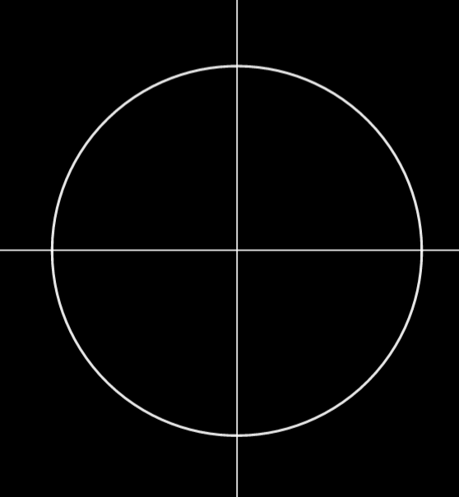







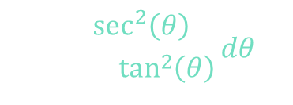

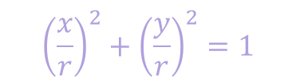






$$\int{\left(\frac{1}{1+u^{2}}\right)du}$$
$$x^{2}+y^{2}=r^{2}$$
$${\left(\frac{x}{r}\right)}^{2}+{\left(\frac{y}{r}\right)}^{2}=1$$
$$u=\tan\left(θ\right)$$
$$r$$
$$θ$$
$$y$$
$$du=\sec^{2}\left(θ\right)dθ$$
$$\sin^{2}\left(θ\right)+\cos^{2}\left(θ\right)=1$$
$$x$$
$$\int{\frac{\sec^{2}\left(θ\right)}{1+\tan^{2}\left(θ\right)}dθ}$$
$$1+{\left(\frac{y}{x}\right)}^{2}={\left(\frac{r}{x}\right)}^{2}$$
$$\int{\frac{\sec^{2}\left(θ\right)}{\sec^{2}\left(θ\right)}dθ}$$
$$1+\tan^{2}\left(θ\right)=\sec^{2}\left(θ\right)$$
$$θ$$
$$=\tan^{−1}\left(u\right)$$
$$M$$

Slide 9




Example
$$\left(x−y\right)dx+\left(x+y\right)dy=0$$
$$M\left(x,y\right)$$
$$N\left(x,y\right)$$
$$\tan^{−1}\left(\frac{y}{x}\right)+\ln{\sqrt{x^{2}+y^{2}}}=C$$
$$\frac{dy}{dx}=\frac{y−x}{y+x}$$
$$y+x≠0$$
$$y≠−x$$
*singular curve
$$M$$

Slide 10









Remark
$$M\left(x, y\right)dx+N\left(x,y\right)dy=0$$
1. Separable?
$$F\left(x\right)dx+G\left(y\right)dy=0$$
$$\frac{∂M}{∂y}=\frac{∂N}{∂x}$$
2. Exact?
$$\frac{\left(M_{y}−N_{x}\right)}{N}$$
$$μ\left(x\right)=e^{\int{\frac{\left(M_{y}−N_{x}\right)}{N}dx}}$$
*in terms of x
3. Made Exact?
$$\frac{\left(N_{x}−M_{y}\right)}{M}$$
$$μ\left(y\right)=e^{\int{\frac{\left(N_{x}−M_{y}\right)}{M}dx}}$$
*in terms of y
4. Homogeneous?
$$M\left(tx, ty\right)=t^{α}M\left(x,y\right)$$
$$N\left(tx, ty\right)=t^{α}N\left(x,y\right)$$

Slide 11



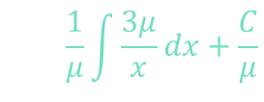

























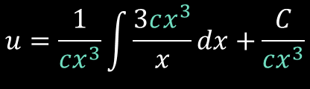

Bernoulli’s Equations
$$\frac{dμ}{dx}=\frac{3μ}{x}$$
$$μ=cx^{3}$$
$$\frac{dy}{dx}+P\left(x\right)y=f\left(x\right)$$
$$y^{n}$$
$$\left(μu\right)′=μ\frac{3}{x}$$
$$u=\frac{1}{μ}\int{\frac{3μ}{x}}dx+\frac{C}{μ}$$
$$n=0$$
$$\frac{dy}{dx}+P\left(x\right)y=f\left(x\right)$$
Linear Equation
$$u=\frac{1}{cx^{3}}\int{\frac{3cx^{3}}{x}}dx+\frac{C}{cx^{3}}$$
$$n=1$$
$$\frac{dy}{dx}+\left(P\left(x\right)−f\left(x\right)\right)y=0$$
Separable Variable
$$u=\frac{1}{x^{3}}x^{3}+Cx^{−3}$$
$$n>1$$
$$u=y^{1−n}$$
Reduce to Linear Equation
$$u=1+Cx^{−3}$$
Example
$$y^{3}=1+Cx^{−3}$$
$$y^{2}\frac{dy}{dx}+\frac{y^{3}}{x}=\frac{1}{x}$$
$$\frac{1}{3}\frac{du}{dx}+\frac{u}{x}=\frac{1}{x}$$
$$P\left(x\right)=f\left(x\right)=\frac{1}{x}$$
$$x\frac{dy}{dx}+y=\frac{1}{y^{2}}$$
$$x^{3}y^{3}=x^{3}+C$$
$$n=−2$$
$$y^{2}\frac{dy}{dx}+\frac{u}{x}=\frac{1}{x}$$
$$\frac{du}{dx}+\frac{3u}{x}=\frac{3}{x}$$
$$\frac{dy}{dx}+\frac{y}{x}=\frac{1}{xy^{2}}$$
$$u=y^{1−n}=y^{3}$$
$$μu′+μ\frac{3}{x}u=μ\frac{3}{x}$$
$$x^{3}(y^{3}−1)=C$$
$$\frac{du}{3}=y^{2}dy$$
$$du=3y^{2}dy$$
$$μ′$$

Slide 12













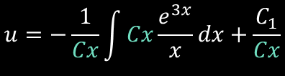












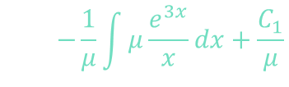





Example
$$x\frac{dy}{dx}−y=e^{3x}y^{2}$$
$$\frac{dy}{dx}+P\left(x\right)y=f\left(x\right)$$
$$y^{n}$$
$$n>1$$
$$\frac{dy}{dx}−\frac{y}{x}=\frac{e^{3x}}{x}y^{2}$$
$$u=y^{1−n}$$
Reduce to Linear Equation
$$P\left(x\right)=\frac{1}{x}$$
$$f\left(x\right)=\frac{e^{3x}}{x}$$
$$n=2$$
$$u=y^{1−2}=y^{−1}$$
$$du=−1y^{−2}dy=−\frac{dy}{y^{2}}$$
$$\frac{1}{y^{2}}\frac{dy}{dx}−\frac{y}{y^{2}x}=\frac{e^{3x}}{x}$$
$$\frac{dμ}{dx}=\frac{μ}{x}$$
$$\frac{dμ}{μ}= \frac{dx}{x}$$
$$u=−\frac{1}{3x}e^{3x}+\frac{C}{x}$$
$$\frac{1}{y^{2}}\frac{dy}{dx}−\frac{1}{y}\left(\frac{1}{x}\right)=\frac{e^{3x}}{x}$$
$$\ln\left|μ\right|=ln|x|$$
$$μ=Cx$$
$$\frac{x}{y}+\frac{e^{3x}}{3}=C$$
$${\left(μu\right)}^{′}=−μ\frac{e^{3x}}{x}$$
$$\frac{1}{y}=−\frac{1}{3x}e^{3x}+\frac{C}{x}$$
$$−du$$
$$u$$
$$−\frac{du}{dx}−\frac{u}{x}=\frac{e^{3x}}{x}$$
$$u=−\frac{1}{μ}\int{μ\frac{e^{3x}}{x}}dx+\frac{C_{1}}{μ}$$
$$\frac{1}{y}+\frac{1}{3x}e^{3x}=\frac{C}{x}$$
$$μu^{′}+μ\frac{1}{x}u=−μ\frac{e^{3x}}{x}$$
$$u=−\frac{1}{Cx}\int{Cx\frac{e^{3x}}{x}}dx+\frac{C_{1}}{Cx}$$
$$\frac{x}{y}+\frac{x}{3x}e^{3x}=C$$
$$μ′$$

Slide 13























Reduction to Separable Variables
$$\frac{dy}{dx}=f\left(Ax+By+C\right)$$
$$u=Ax+By+C$$
Reduce to Separable Variables
Example
$$\frac{du}{\sec^{2}\left(u\right)}=2dx$$
$$\frac{2x+2y}{2}+\frac{\sin\left(2\left(2x+2y\right)\right)}{4}= 2x+C$$
$$\frac{dy}{dx}=\tan^{2}{(2x+2y)}$$
$$\frac{dy}{dx}=f\left(Ax+By+C\right)$$
$$x+y+\frac{\sin\left(4x+4y\right)}{4}= 2x+C$$
$$\cos^{2}\left(u\right)du=2dx$$
$$Ax+By+C$$
$$\left(\frac{1+\cos\left(2u\right)}{2}\right)du=2dx$$
$$y+\frac{\sin\left(4x+4y\right)}{4}= x+C$$
$$u=2x+2y$$
$$\frac{1}{2}\frac{du}{dx}=\tan^{2}\left(u\right)+1$$
$$\frac{du}{dx}=2\frac{dx}{dx}+2\frac{dy}{dx}$$
$$\left(\frac{1}{2}+\frac{\cos\left(2u\right)}{2}\right)du= 2dx$$
*Separable Variables
$$\frac{du}{dx}=2+2\frac{dy}{dx}$$
$$\frac{dy}{dx}=\frac{1}{2}\frac{du}{dx}−\frac{2}{2}$$
$$y−x+\frac{\sin\left(4x+4y\right)}{4}=C$$
$$\frac{du}{\tan^{2}\left(u\right)+1}=2dx$$
$$\frac{u}{2}+\frac{\sin\left(2u\right)}{4}= 2x+C$$
$$\frac{1}{2}\frac{du}{dx}−1=\tan^{2}\left(u\right)$$
$$\sec^{2}\left(u\right)$$

Slide 14

Reduction to Separable Variables
$$\frac{dy}{dx}=f\left(Ax+By+C\right)$$
$$u=Ax+By+C$$
Reduce to Separable Variables
Example
$$\frac{dy}{dx}=\tan^{2}{(2x+2y)}$$
$$y−x+\frac{\sin\left(4x+4y\right)}{4}=C$$

Slide 15






















$$\frac{x}{r}=\cos\left(θ\right)$$
$$\frac{y}{r}=\sin\left(θ\right)$$
$$x=r\cos\left(θ\right)$$
$$y=r\sin\left(θ\right)$$
$$1$$
$$1$$
$$r=1$$
$$\sin\left(θ\right)$$
$$\sin\left(2θ\right)$$
$$θ$$
$$θ$$
$$θ$$
$$\cos\left(θ\right)$$
$$\cos\left(θ\right)$$
$$\cos\left(2θ\right)$$
$$r^{∗}=\cos\left(θ\right)+\cos\left(θ\right)=2\cos\left(θ\right)$$
$$\cos\left(2θ\right)+1=2\cos^{2}\left(θ\right)$$
$$\cos\left(2θ\right)=2\cos^{2}\left(θ\right)−1$$
$$r^{∗}\cos\left(θ\right)$$
$$M$$
$$r^{∗}\sin\left(θ\right)$$
Cosine Double-Angle
$$2\cos\left(θ\right)\cos\left(θ\right)$$
$$2\cos\left(θ\right)\sin\left(θ\right)$$
$$2\cos^{2}\left(θ\right)$$
$$\cos^{2}\left(θ\right)=\frac{\cos\left(2θ\right)+1}{2}$$

Slide 16












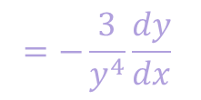

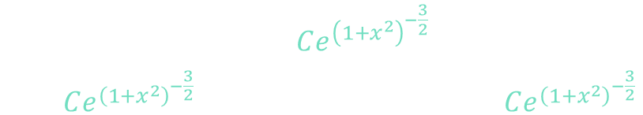


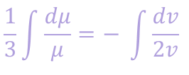






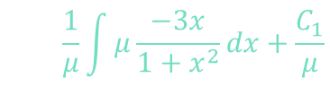

















Example
$$\frac{1}{3}\ln\left|μ\right|=−\frac{1}{2}\ln\left|v\right|+C$$
$$\left(1+x^{2}\right)\frac{dy}{dx}=xy\left(y^{3}−1\right)$$
$$\frac{dy}{dx}+P\left(x\right)y=f\left(x\right)$$
$$y^{n}$$
$$\frac{dμ}{dx}=−\frac{3μx}{1+x^{2}}$$
$$μ=Ce^{v^{−\frac{3}{2}}}$$
$$\frac{dy}{dx}=\frac{xy\left(y^{3}−1\right)}{\left(1+x^{2}\right)}$$
$$n>1$$
$$\frac{dμ}{3μ}= \frac{−x}{1+x^{2}}dx$$
$$u=y^{1−n}$$
Reduce to Linear Equation
$$\frac{dy}{dx}=\frac{x}{1+x^{2}}\left(y^{4}−y\right)$$
$$v=1+x^{2}$$
$$dv=2xdx$$
$$\frac{dv}{2}=xdx$$
$$n=4$$
$$u=y^{−3}$$
$$=−\frac{3}{y^{4}}\frac{dy}{dx}$$
$$\frac{1}{3}\int{\frac{dμ}{μ}}=− \int{\frac{dv}{2v} }$$
$$\frac{dy}{dx}=\frac{x}{1+x^{2}}y^{4}−\frac{x}{1+x^{2}}y$$
$$\frac{du}{dx}=−3y^{−4}\frac{dy}{dx}$$
$$−\frac{1}{3}\frac{du}{dx}=\frac{1}{y^{4}}\frac{dy}{dx}$$
$$μ=Ce^{{\left(1+x^{2}\right)}^{−\frac{3}{2}}}$$
$$\frac{dy}{dx}+\frac{x}{1+x^{2}}y=\frac{x}{1+x^{2}}y^{4}$$
$$\left(μu\right)′=μ\frac{−3x}{1+x^{2}}$$
$$u=\frac{1}{μ}\int{μ\frac{−3x}{1+x^{2}}}dx+\frac{C_{1}}{μ}$$
$$y^{n}$$
$$\frac{du}{dx}−3\frac{x}{1+x^{2}}u=−3\frac{x}{1+x^{2}}$$
$$P\left(x\right)$$
$$f\left(x\right)$$
$$P\left(x\right)$$
$$f\left(x\right)$$
$$u=\frac{1}{Ce^{{\left(1+x^{2}\right)}^{−\frac{3}{2}}}}\int{−\frac{3x Ce^{{\left(1+x^{2}\right)}^{−\frac{3}{2}}}}{1+x^{2}}}dx+\frac{C_{1}}{Ce^{{\left(1+x^{2}\right)}^{−\frac{3}{2}}}}$$
$$\frac{1}{y^{4}}\frac{dy}{dx}+\frac{x}{1+x^{2}}\left(\frac{y}{y^{4}}\right)=\frac{x}{1+x^{2}}$$
$$u^{′}+\frac{−3x}{1+x^{2}}u=\frac{−3x}{1+x^{2}}$$
$$3$$
$$u$$
$$μu^{′}+μ\frac{−3x}{1+x^{2}}u=μ\frac{−3x}{1+x^{2}}$$
$$−\frac{1}{3}\frac{du}{dx}$$
$$+\frac{x}{1+x^{2}}u=\frac{x}{1+x^{2}}$$
$$μ′$$

Slide 17

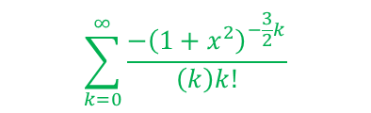
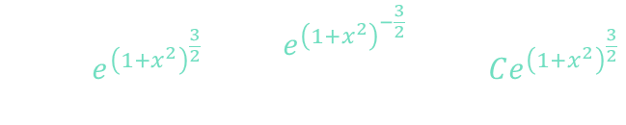


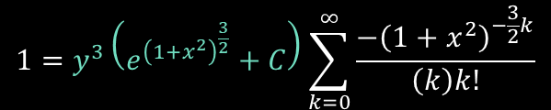
Example
$$\left(1+x^{2}\right)\frac{dy}{dx}=xy\left(y^{3}−1\right)$$
$$n=4$$
$$u=y^{−3}$$
$$\frac{dy}{dx}=\frac{xy\left(y^{3}−1\right)}{\left(1+x^{2}\right)}$$
$$u=−e^{{\left(1+x^{2}\right)}^{\frac{3}{2}}}\int{\frac{3x e^{{\left(1+x^{2}\right)}^{−\frac{3}{2}}}}{1+x^{2}}dx}+Ce^{{\left(1+x^{2}\right)}^{\frac{3}{2}}}$$
$$\sum_{k=0}^{∞}{\frac{−{\left(1+x^{2}\right)}^{−\frac{3}{2}k}}{\left(k\right)k!}}$$
$$u=−e^{{\left(1+x^{2}\right)}^{\frac{3}{2}}}\sum_{k=0}^{∞}{\frac{−{\left(1+x^{2}\right)}^{−\frac{3}{2}k}}{\left(k\right)k!}}+Ce^{{\left(1+x^{2}\right)}^{\frac{3}{2}}}$$
$$1=y^{3}\left(e^{{\left(1+x^{2}\right)}^{\frac{3}{2}}}+C\right)\sum_{k=0}^{∞}{\frac{−{\left(1+x^{2}\right)}^{−\frac{3}{2}k}}{\left(k\right)k!}}$$

Slide 18

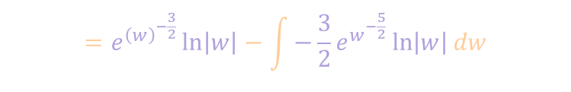




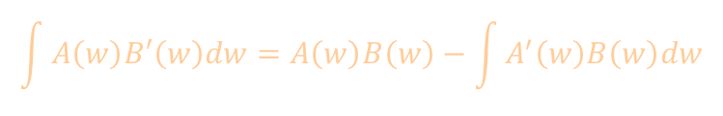



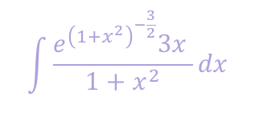


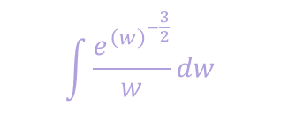












Integration By Parts
$$\int{A\left(w\right)B′\left(w\right)dw}=A\left(w\right)B\left(w\right)−\int{A^{′}\left(w\right)B\left(w\right)dw}$$
$$\int{\frac{e^{{\left(1+x^{2}\right)}^{−\frac{3}{2}}}3x }{1+x^{2}}dx}$$
$$w=1+x^{2}$$
$$\frac{dw}{2}=xdx$$
$A\left(w\right)=$ $e^{{\left(w\right)}^{−\frac{3}{2}}}$
$$B^{′}\left(w\right)dw=\frac{dw}{w}$$
$$dw=2xdx$$
$$\int{\frac{e^{{\left(w\right)}^{−\frac{3}{2}}}}{w}dw}$$
$$=e^{{\left(w\right)}^{−\frac{3}{2}}}\ln\left|w\right|−\int{−\frac{3}{2}e^{w^{−\frac{5}{2}}}\ln\left|w\right|dw}$$
$$A^{′}\left(w\right)=−\frac{3}{2}e^{w^{−\frac{5}{2}}}$$
$$B^{′}\left(w\right)=\frac{1}{w}$$
$$B\left(w\right)=\ln\left|w\right|$$
Tabular Method
$$A\left(w\right)$$
$$B^{′}\left(w\right)dw$$
$$e^{{\left(w\right)}^{−\frac{3}{2}}}$$
$$\frac{1}{w}$$
$$−\frac{3}{2}e^{w^{−\frac{5}{2}}}$$
$$\ln\left|w\right|$$
$$−\frac{3}{2}\left(−\frac{5}{2}\right)e^{{\left(w\right)}^{−\frac{7}{2}}}$$
$$w\ln\left|w\right|−w$$
$$.$$
$$.$$
$$.$$
$$.$$
$$.$$
$$.$$

Slide 19
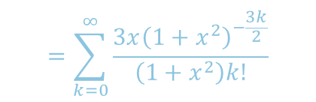

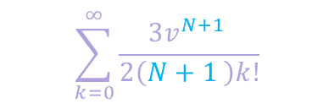

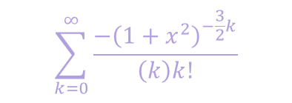



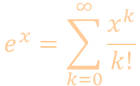
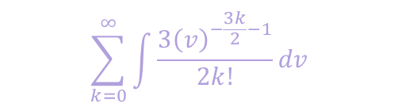


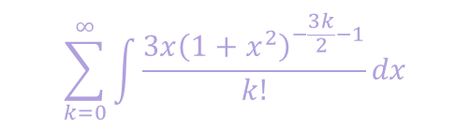


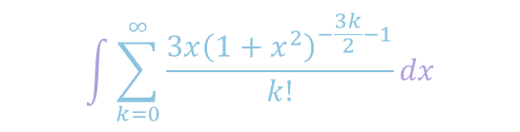
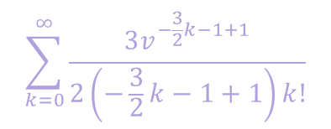

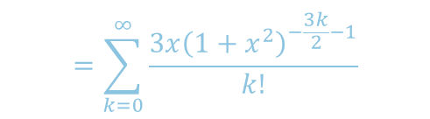
Taylor Series
$$\int{\frac{e^{{\left(1+x^{2}\right)}^{−\frac{3}{2}}}3x }{1+x^{2}}dx}$$
$$e^{x}=\sum_{k=0}^{∞}{\frac{x^{k}}{k!}}$$
$$=1+x+\frac{x^{2}}{2!}+\frac{x^{3}}{3!}+…$$
$$\int{\sum_{k=0}^{∞}{\frac{3x{\left(1+x^{2}\right)}^{−\frac{3k}{2}−1}}{k!}}dx}$$
$$=\sum_{k=0}^{∞}{\frac{{\left(1+x^{2}\right)}^{−\frac{3k}{2}}}{k!}}$$
$=1+$ ${\left(1+x^{2}\right)}^{−\frac{3}{2}}+\frac{{\left(1+x^{2}\right)}^{−3}}{2!}+\frac{{\left(1+x^{2}\right)}^{−\frac{9}{2}}}{3!}+…$
$$e^{{\left(1+x^{2}\right)}^{−\frac{3}{2}}}$$
$$=\sum_{k=0}^{∞}{\frac{3x{\left(1+x^{2}\right)}^{−\frac{3k}{2}}}{\left(1+x^{2}\right)k!}}$$
$$=\sum_{k=0}^{∞}{\frac{3x{\left(1+x^{2}\right)}^{−\frac{3k}{2}−1}}{k!}}$$
$$\sum_{k=0}^{∞}{\int{\frac{3x{\left(1+x^{2}\right)}^{−\frac{3k}{2}−1}}{k!}dx}}$$
$$v=1+x^{2}$$
$$\frac{3x}{1+x^{2}}e^{{\left(1+x^{2}\right)}^{−\frac{3}{2}}}$$
$$dv=2xdx$$
$$\frac{dv}{2}=xdx$$
$$\sum_{k=0}^{∞}{\int{\frac{3{\left(v\right)}^{−\frac{3k}{2}−1}}{2k!}dv}}$$
$$\sum_{k=0}^{∞}{\frac{3v^{−\frac{3}{2}k−1+1}}{2\left(−\frac{3}{2}k−1+1\right)k!}}$$
$$\sum_{k=0}^{∞}{\int{\frac{3{\left(v\right)}^{N}}{2k!}dv}}$$
$$\sum_{k=0}^{∞}{\frac{−v^{−\frac{3}{2}k}}{\left(k\right)k!}}$$
$$\sum_{k=0}^{∞}{\frac{−{\left(1+x^{2}\right)}^{−\frac{3}{2}k}}{\left(k\right)k!}}$$
$$\sum_{k=0}^{∞}{\frac{3v^{N+1 }}{2\left(N+1 \right)k!}}$$

Slide 20

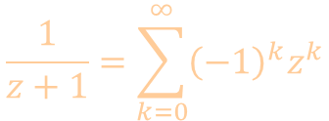
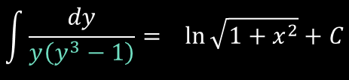
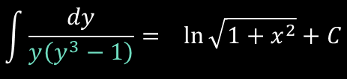







Example
$$\left(1+x^{2}\right)\frac{dy}{dx}=xy\left(y^{3}−1\right)$$
Taylor Series
$$\frac{dy}{dx}=\frac{xy\left(y^{3}−1\right)}{\left(1+x^{2}\right)}$$
Separable Variables
$$\frac{dy}{y\left(y^{3}−1\right)}= \frac{xdx}{\left(1+x^{2}\right)}$$
$$u=1+x^{2}$$
$$du=2xdx$$
$$\int{\frac{dy}{y\left(y^{3}−1\right)}}= \ln{\sqrt{1+x^{2}}}+C$$
$$\frac{du}{2}=xdx$$
$$\frac{1}{z+1}=\sum_{k=0}^{∞}{{\left(−1\right)}^{k}z^{k}}$$
$$\int{\frac{dy}{y\left(y^{3}−1\right)}}= \ln{\sqrt{1+x^{2}}}+C$$
$$=1+x+\frac{x^{2}}{2!}+\frac{x^{3}}{3!}+…$$

Slide 21









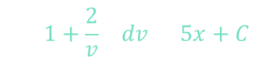













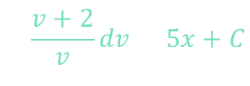














Example
$$\frac{dy}{dx}=\frac{3x+2y}{3x+2y+5}$$
$$\frac{dy}{dx}=f\left(Ax+By+C\right)$$
$$Ax+By+C$$
$$u=Ax+By+C$$
Reduce to Separable Variables
$$u=3x+2y+5$$
$$u−5=3x+2y$$
$$v=u−2$$
$${\left(3x+2y+3\right)}^{2}e^{2y}=\frac{Ce^{5x}}{e^{3x}}$$
$$\frac{du}{dx}=3\frac{dx}{dx}+2\frac{dy}{dx}$$
$$dv=du$$
$$v+2\ln\left|v\right|=5x+C$$
$$\frac{dy}{dx}=\frac{1}{2}\frac{du}{dx}−\frac{3}{2}$$
$$u=v+2$$
$$v+\ln\left(v^{2}\right) = 5x+C$$
$$\frac{du}{dx}=3+2\frac{dy}{dx}$$
$$e^{( )}$$
$$e^{( )}$$
$${\left(3x+2y+3\right)}^{2}e^{2y}=Ce^{2x}$$
$$e^{v}e^{\ln\left(v^{2}\right)}=Ce^{5x}$$
$$\frac{1}{2}\frac{du}{dx}−\frac{3}{2}=\frac{u−5}{u}$$
$$\frac{du}{dx}=\frac{5u−10}{u}$$
*Separable
Variables
$$\frac{e^{2y}}{e^{2x}}{\left(3x+2y+3\right)}^{2}=C$$
$$v^{2}e^{v}=Ce^{5x}$$
$$u^{′}−3=\frac{2u−10}{u}$$
$$\frac{u}{5u−10}du= dx$$
$${\left(\frac{e^{y}}{e^{x}}\left(3x+2y+3\right)\right)}^{2}=C$$
$${\left(u−2\right)}^{2}e^{\left(u−2\right)}=Ce^{5x}$$
$$u^{′}−3=2−\frac{10}{u}$$
$$\int{\frac{u}{u−2}du}=5\int{dx}$$
$${\left(3x+2y+5−2\right)}^{2}e^{\left(3x+2y+5−2\right)}=Ce^{5x}$$
$$u^{′}=5−\frac{10}{u}$$
$$\int{\frac{v+2}{v}dv}=5x+C$$
$${\left(3x+2y+3\right)}^{2}e^{\left(3x+2y+3\right)}=Ce^{5x}$$
$$e^{\left(y−x\right)}\left(3x+2y+3\right)=C$$
$$u^{′}=\frac{5u−10}{u}$$
$$\int{\left(1+\frac{2}{v} \right)dv}=5x+C$$
$${\left(3x+2y+3\right)}^{2}e^{3x}e^{2y}e^{3}=Ce^{5x}$$

Slide 22




Example
$$\frac{dy}{dx}=\frac{3x+2y}{3x+2y+5}$$
$$\frac{dy}{dx}=f\left(Ax+By+C\right)$$
$$Ax+By+C$$
$$u=Ax+By+C$$
Reduce to Separable Variables
$$e^{\left(y−x\right)}\left(3x+2y+3\right)=C$$
$$3x+2y+5≠0$$
$$2y≠−3x−5$$
$$y≠−\frac{3}{2}x−\frac{5}{2}$$

